Slide 1
BIEN 401 Biomedical Mass Transport Class 4 Flow Properties
notes prepared by
Dr. Louis Reis
Created on 3/13/2022

Slide 2
Review of Fluid Mechanics
We will briefly cover some of the major talking points from BIEN 301 in regards to bulk fluid transport and conservation equations (momentum, mass, and energy)
Some of the more important concepts that will be review today will be useful in some of our analyses
You are always encouraged to review your notes and textbook from BIEN 301
We will also introduce unsteady flow and look at an example of that. You will note that there are many similarities between the equations we used in fluid mechanics and the ones we will use in this course on mass transport.

Slide 3
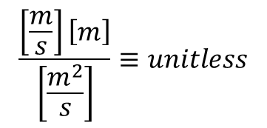
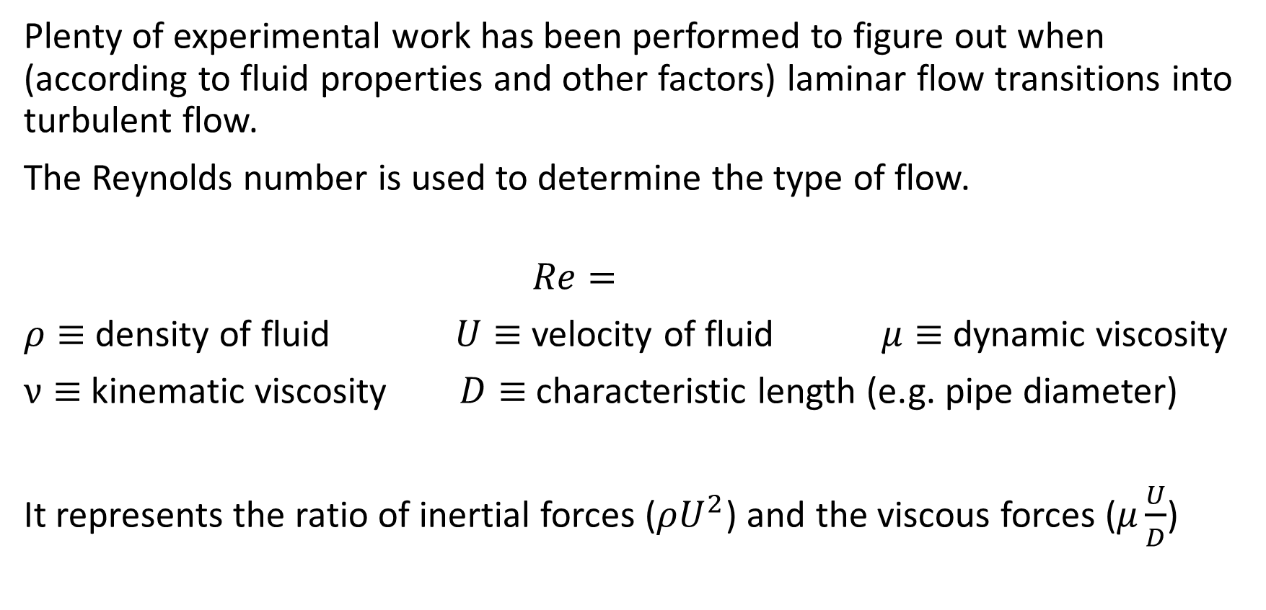
Reynold’s Number
Plenty of experimental work has been performed to figure out when (according to fluid properties and other factors) laminar flow transitions into turbulent flow.
The Reynolds number is used to determine the type of flow.
$$Re=$$
$ρ≡$ density of fluid $U≡$ velocity of fluid $μ≡$ dynamic viscosity
$ν≡$ kinematic viscosity $D≡$ characteristic length (e.g. pipe diameter)
It represents the ratio of inertial forces ($ρU^{2}$) and the viscous forces ($μ\frac{U}{D}$)
What are the units for Re?
$$\frac{\left[\frac{m}{s}\right]\left[m\right]}{\left[\frac{m^{2}}{s}\right]}≡unitless$$

Slide 4
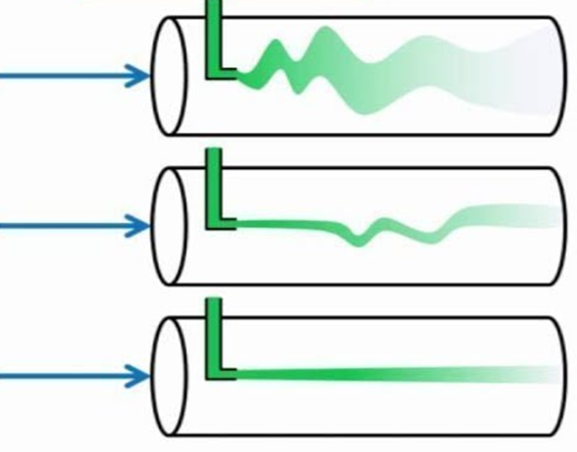
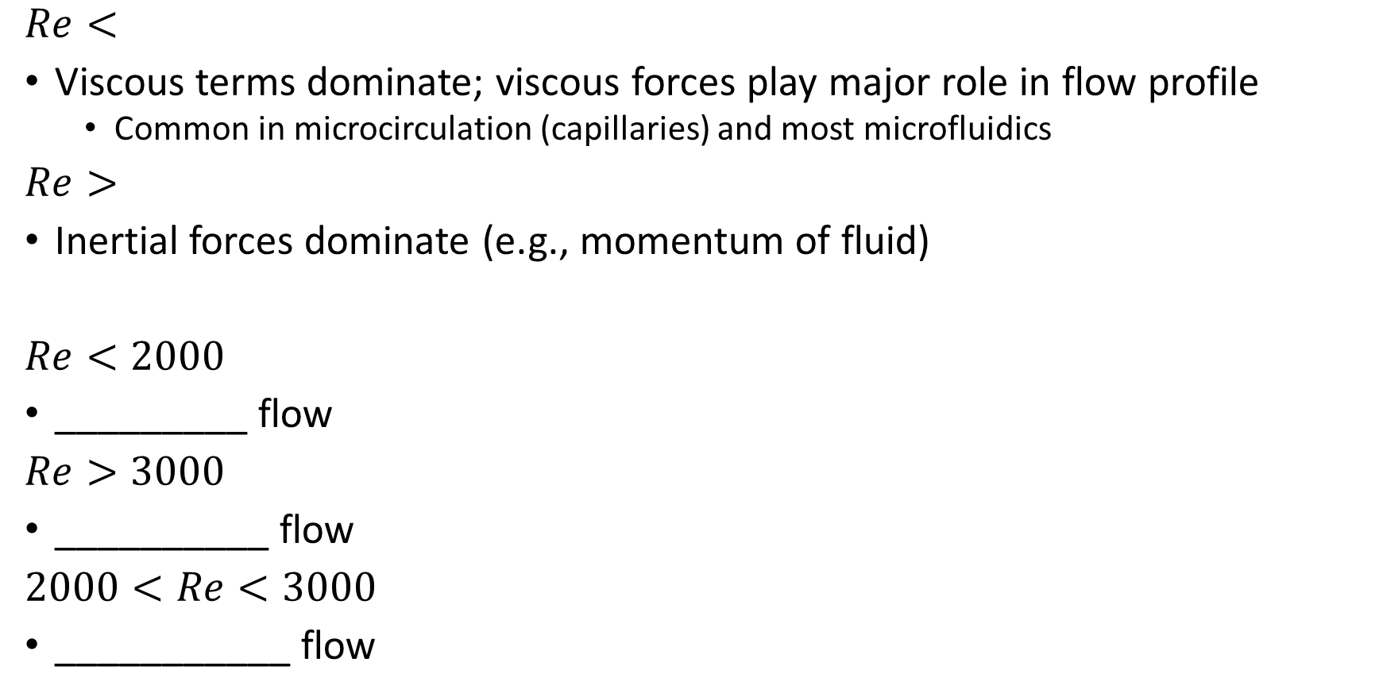
Reynold’s Number and Flow Type
$Re<$
Viscous terms dominate; viscous forces play major role in flow profile
Common in microcirculation (capillaries) and most microfluidics
$Re>$
Inertial forces dominate (e.g., momentum of fluid)
$Re<2000$
_________ flow
$Re>3000$
__________ flow
$2000<Re<3000$
___________ flow
Turbulent
(unpredictable, rapid mixing)
Transitional
(turbulent outbursts)
Laminar
(predictable, slow mixing)

Slide 5
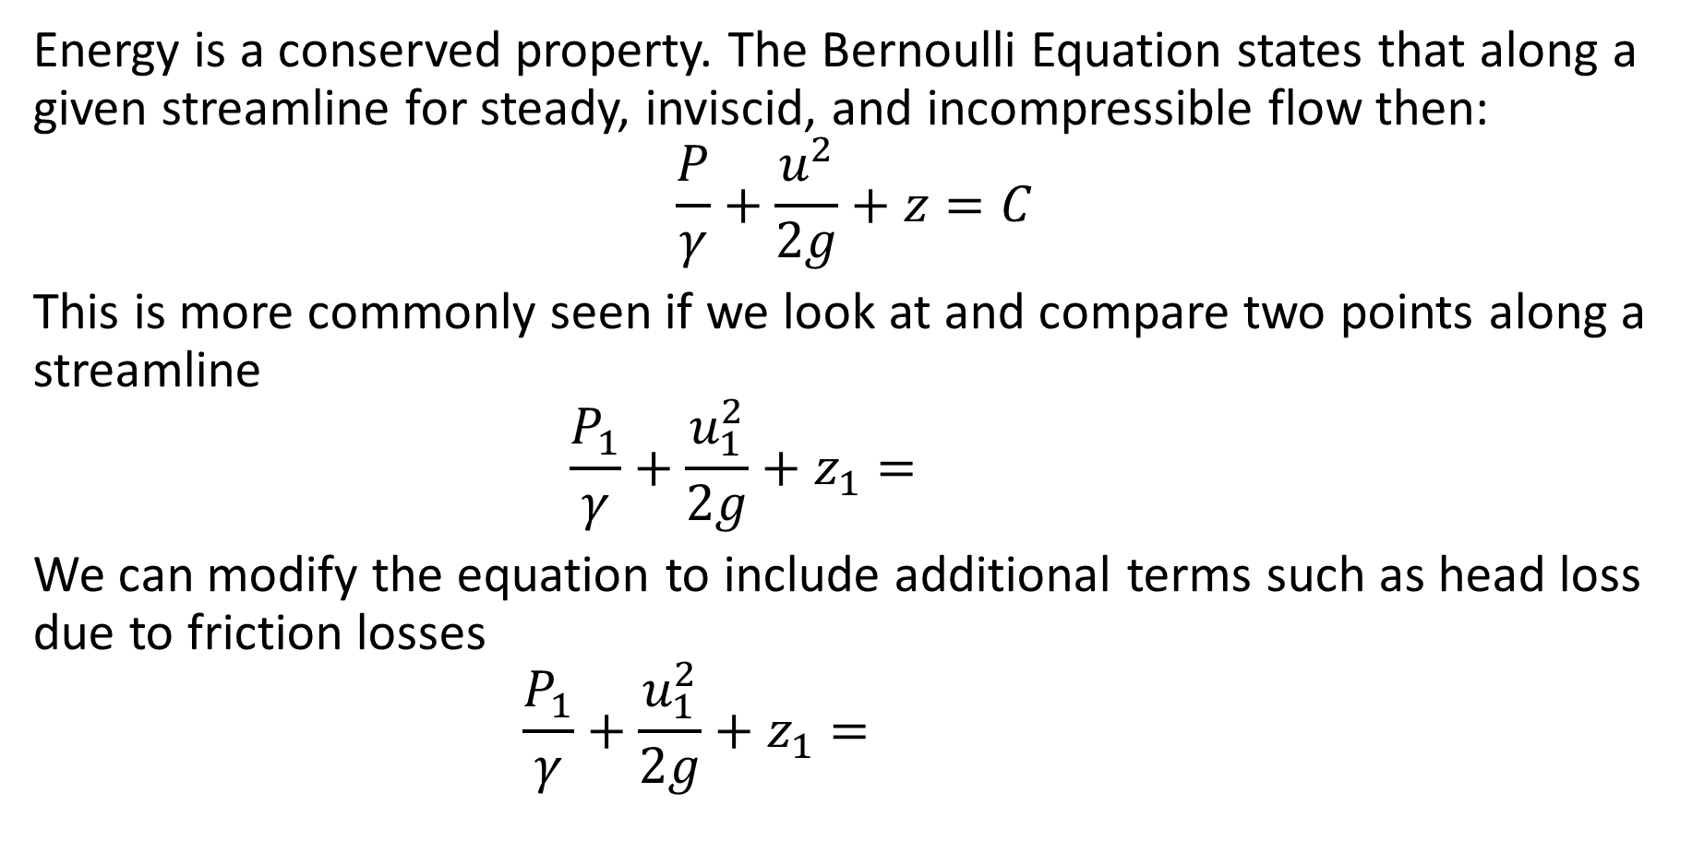
Bernoulli Equation
Energy is a conserved property. The Bernoulli Equation states that along a given streamline for steady, inviscid, and incompressible flow then:
$$\frac{P}{γ}+\frac{u^{2}}{2g}+z=C$$
This is more commonly seen if we look at and compare two points along a streamline
$$\frac{P_{1}}{γ}+\frac{u_{1}^{2}}{2g}+z_{1}=$$
We can modify the equation to include additional terms such as head loss due to friction losses
$$\frac{P_{1}}{γ}+\frac{u_{1}^{2}}{2g}+z_{1}=$$

Slide 6
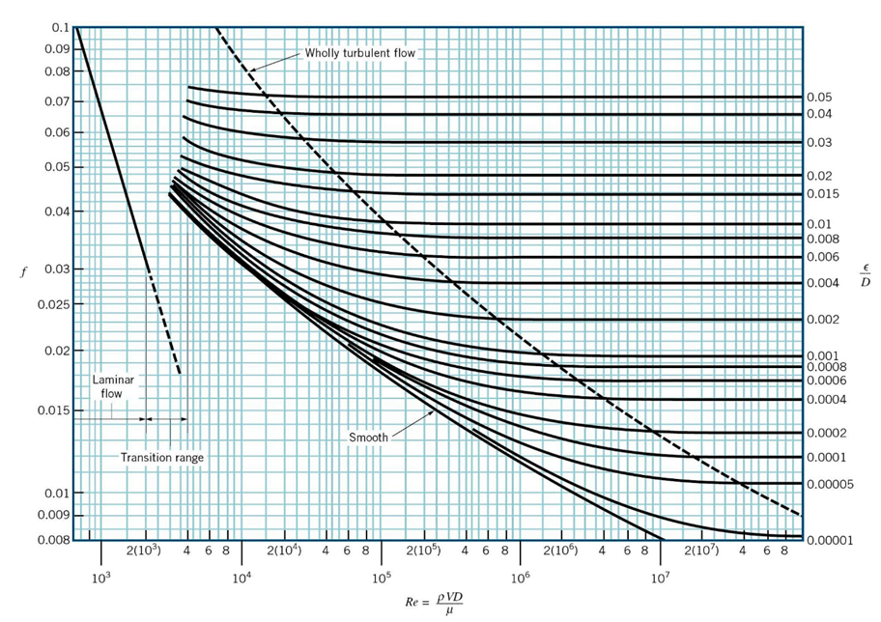
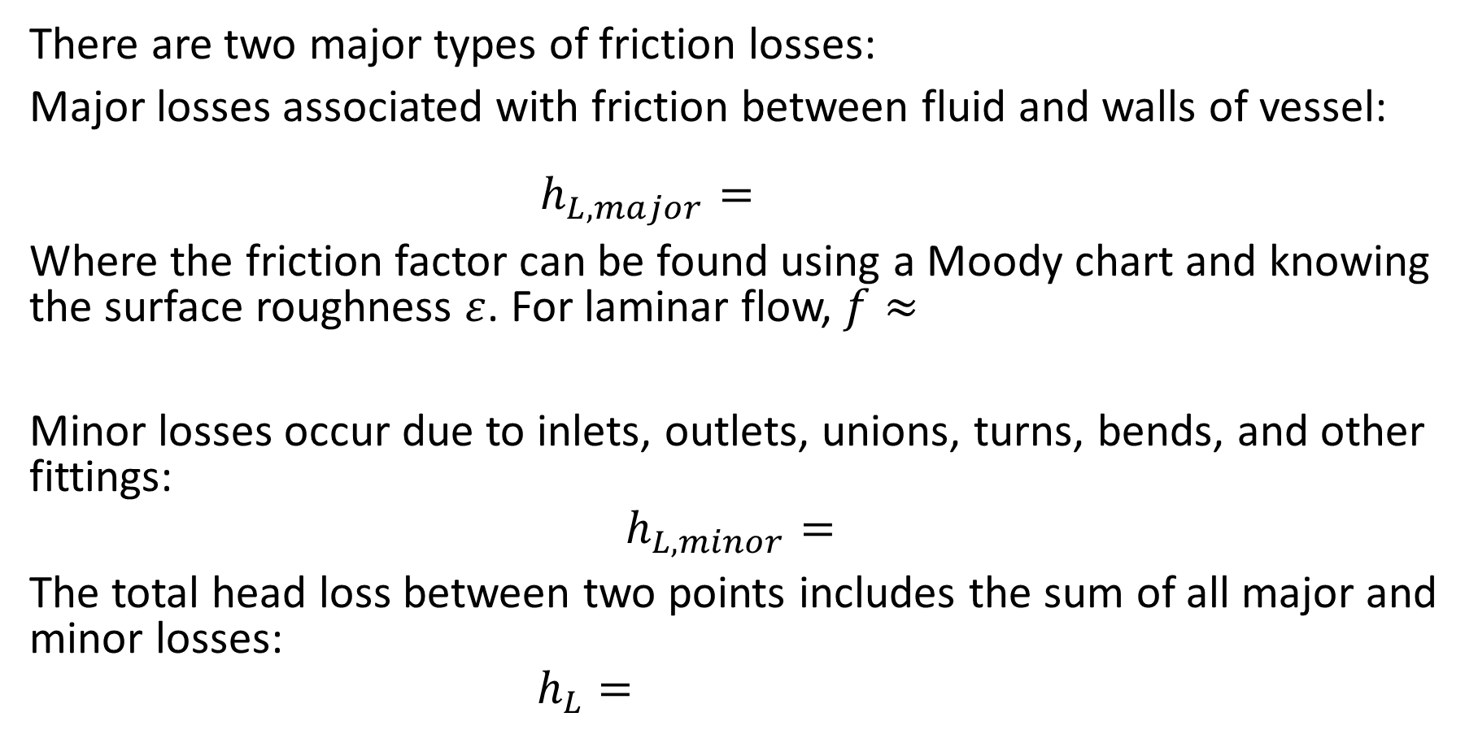
Friction Losses
There are two major types of friction losses:
Major losses associated with friction between fluid and walls of vessel:
$$h_{L,major}=$$
Where the friction factor can be found using a Moody chart and knowing the surface roughness $ε$. For laminar flow, $f≈$
Minor losses occur due to inlets, outlets, unions, turns, bends, and other fittings:
$$h_{L,minor}=$$
The total head loss between two points includes the sum of all major and minor losses:
$$h_{L}=$$

Slide 7
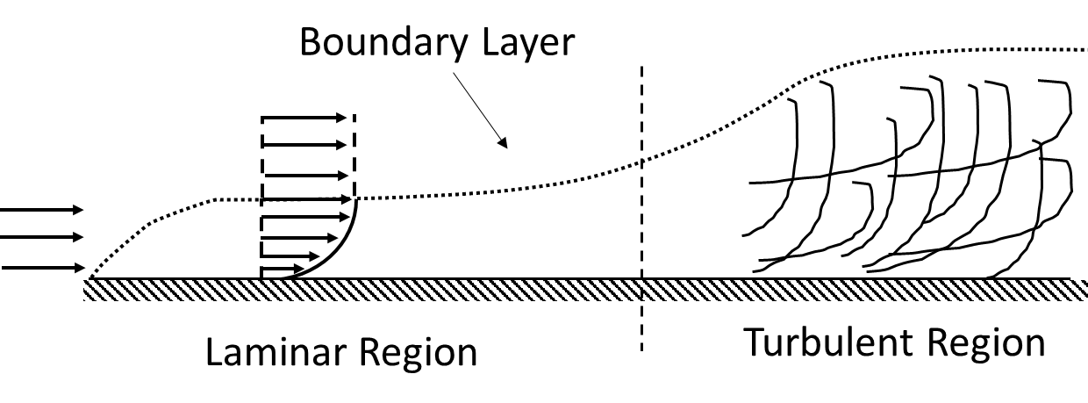
Boundary Layer Formation
When a surface is introduced into a flow field (e.g., a flat plate introduced to a uniform velocity field), a boundary layer forms on the surface.
Due to no slip conditions the velocity at the surface is 0. As we move further from the surface the flow will hold its uniform velocity. The distance from the surface to the locating in the field where the flow is once more uniform is the boundary layer. The boundary layer grows along the length of the surface.

Slide 8
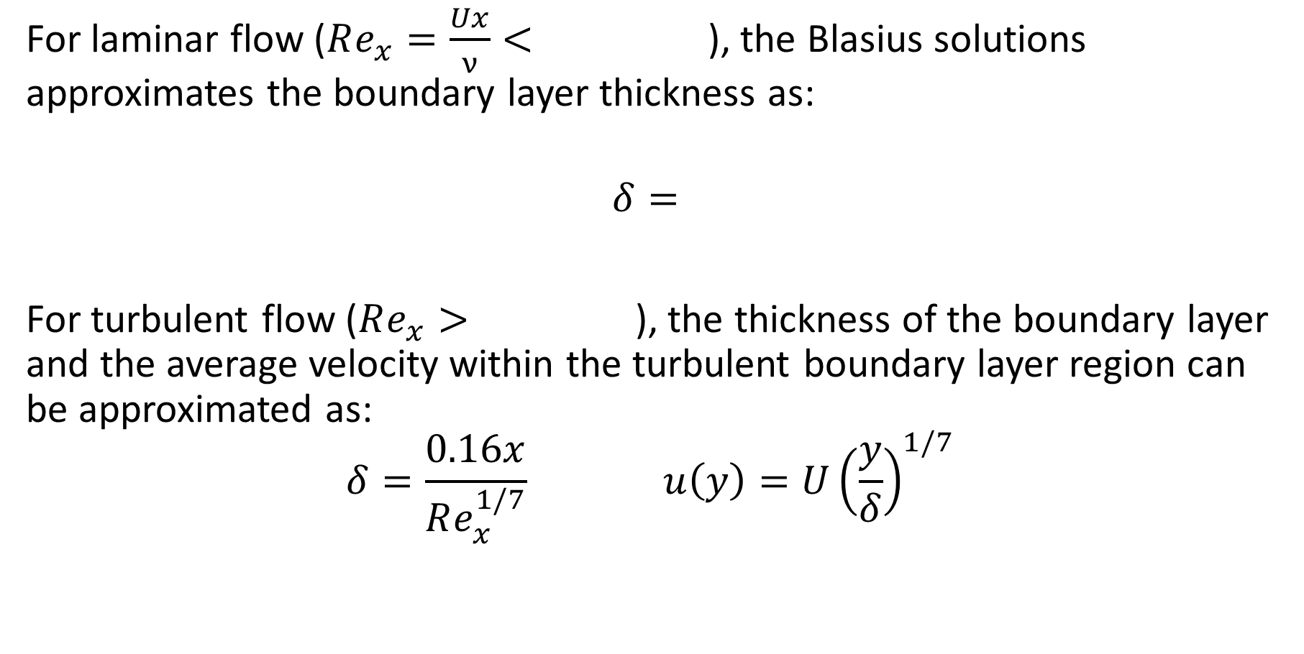
Boundary Layer Equations
For laminar flow ($Re_{x}=\frac{Ux}{ν}<$), the Blasius solutions approximates the boundary layer thickness as:
$$δ=$$
For turbulent flow ($Re_{x}>$), the thickness of the boundary layer and the average velocity within the turbulent boundary layer region can be approximated as:
$$δ=\frac{0.16x}{Re_{x}^{1/7}} u\left(y\right)=U{\left(\frac{y}{δ}\right)}^{1/7}$$

Slide 9
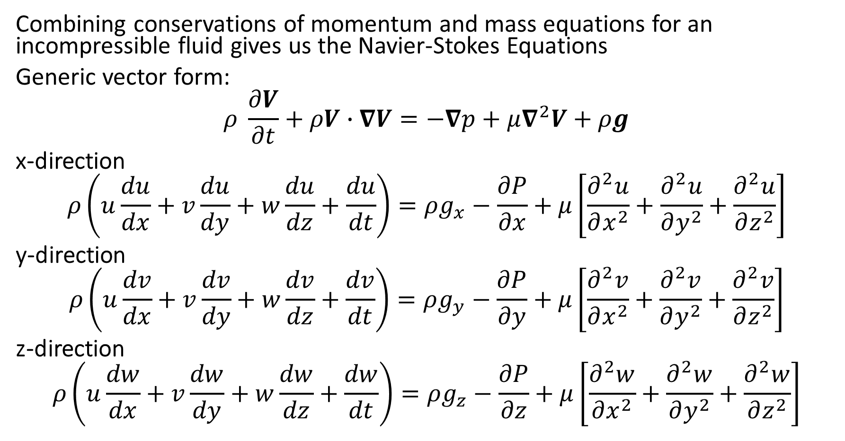
Navier-Stokes Equations (Cartesian)
Combining conservations of momentum and mass equations for an incompressible fluid gives us the Navier-Stokes Equations
Generic vector form:
$$ρ \frac{∂V}{∂t}+ρV∙∇V=−∇p+μ∇^{2}V+ρg$$
x-direction
$$ρ\left(u\frac{du}{dx}+v\frac{du}{dy}+w\frac{du}{dz}+\frac{du}{dt}\right)=ρg_{x}−\frac{∂P}{∂x}+μ\left[\frac{∂^{2}u}{∂x^{2}}+\frac{∂^{2}u}{∂y^{2}}+\frac{∂^{2}u}{∂z^{2}}\right]$$
y-direction
$$ρ\left(u\frac{dv}{dx}+v\frac{dv}{dy}+w\frac{dv}{dz}+\frac{dv}{dt}\right)=ρg_{y}−\frac{∂P}{∂y}+μ\left[\frac{∂^{2}v}{∂x^{2}}+\frac{∂^{2}v}{∂y^{2}}+\frac{∂^{2}v}{∂z^{2}}\right]$$
z-direction
$$ρ\left(u\frac{dw}{dx}+v\frac{dw}{dy}+w\frac{dw}{dz}+\frac{dw}{dt}\right)=ρg_{z}−\frac{∂P}{∂z}+μ\left[\frac{∂^{2}w}{∂x^{2}}+\frac{∂^{2}w}{∂y^{2}}+\frac{∂^{2}w}{∂z^{2}}\right]$$

Slide 10
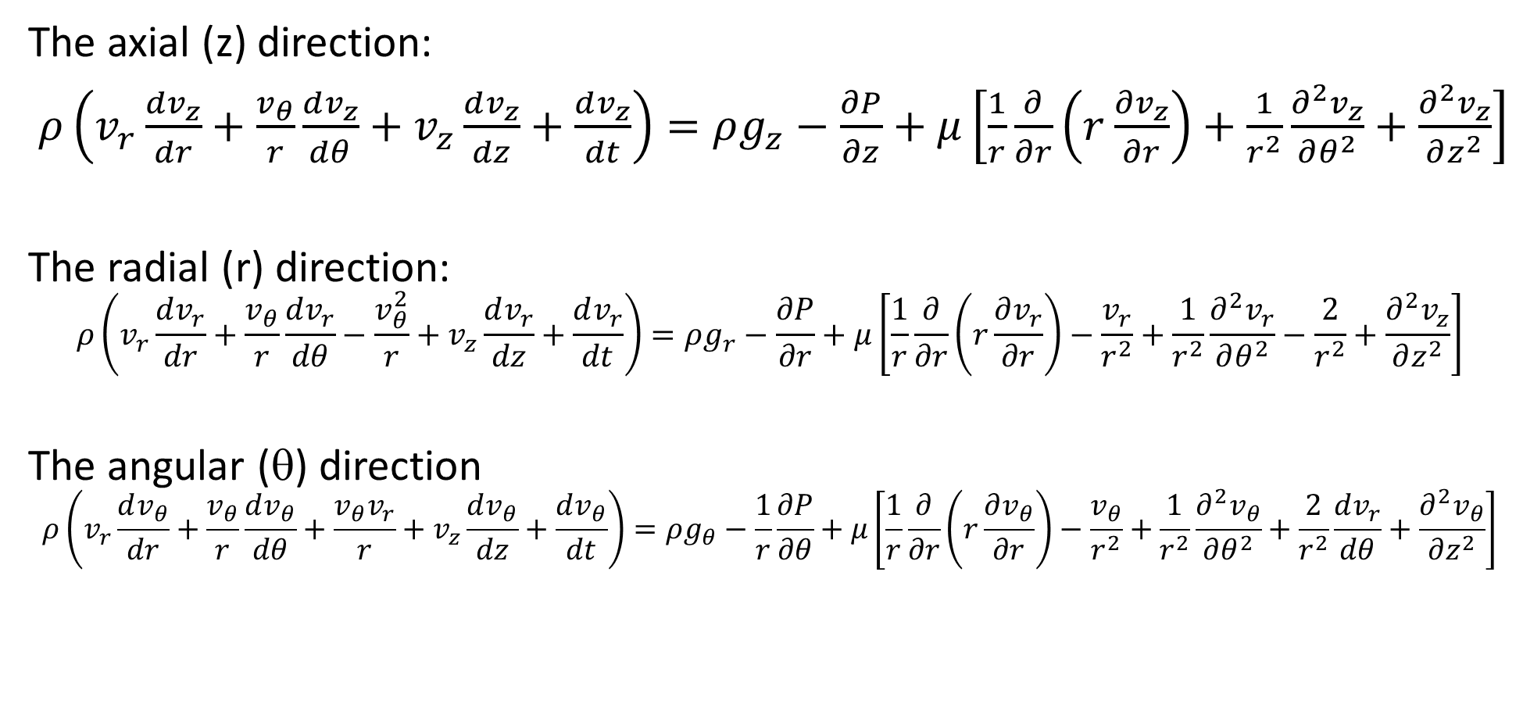
Navier-Stokes Equations (Cylindrical)
The axial (z) direction:
$ρ\left(v_{r}\frac{dv_{z}}{dr}+\frac{v_{θ}}{r}\frac{dv_{z}}{dθ}+v_{z}\frac{dv_{z}}{dz}+\frac{dv_{z}}{dt}\right)=ρg_{z}−\frac{∂P}{∂z}+μ\left[\frac{1}{r}\frac{∂}{∂r}\left(r\frac{∂v_{z}}{∂r}\right)+\frac{1}{r^{2}}\frac{∂^{2}v_{z}}{∂θ^{2}}+\frac{∂^{2}v_{z}}{∂z^{2}}\right]$
The radial (r) direction:
$$ρ\left(v_{r}\frac{dv_{r}}{dr}+\frac{v_{θ}}{r}\frac{dv_{r}}{dθ}−\frac{v_{θ}^{2}}{r}+v_{z}\frac{dv_{r}}{dz}+\frac{dv_{r}}{dt}\right)=ρg_{r}−\frac{∂P}{∂r}+μ\left[\frac{1}{r}\frac{∂}{∂r}\left(r\frac{∂v_{r}}{∂r}\right)−\frac{v_{r}}{r^{2}}+\frac{1}{r^{2}}\frac{∂^{2}v_{r}}{∂θ^{2}}−\frac{2}{r^{2}}+\frac{∂^{2}v_{z}}{∂z^{2}}\right]$$
The angular (θ) direction
$$ρ\left(v_{r}\frac{dv_{θ}}{dr}+\frac{v_{θ}}{r}\frac{dv_{θ}}{dθ}+\frac{v_{θ}v_{r}}{r}+v_{z}\frac{dv_{θ}}{dz}+\frac{dv_{θ}}{dt}\right)=ρg_{θ}−\frac{1}{r}\frac{∂P}{∂θ}+μ\left[\frac{1}{r}\frac{∂}{∂r}\left(r\frac{∂v_{θ}}{∂r}\right)−\frac{v_{θ}}{r^{2}}+\frac{1}{r^{2}}\frac{∂^{2}v_{θ}}{∂θ^{2}}+\frac{2}{r^{2}}\frac{dv_{r}}{dθ}+\frac{∂^{2}v_{θ}}{∂z^{2}}\right]$$

Slide 11
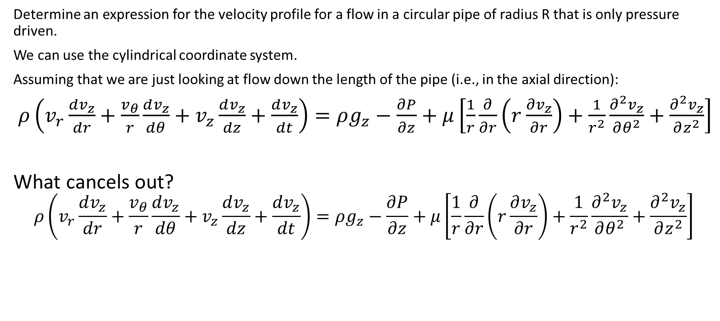
Navier-Stokes Example
Determine an expression for the velocity profile for a flow in a circular pipe of radius R that is only pressure driven.
We can use the cylindrical coordinate system.
Assuming that we are just looking at flow down the length of the pipe (i.e., in the axial direction):
$ρ\left(v_{r}\frac{dv_{z}}{dr}+\frac{v_{θ}}{r}\frac{dv_{z}}{dθ}+v_{z}\frac{dv_{z}}{dz}+\frac{dv_{z}}{dt}\right)=ρg_{z}−\frac{∂P}{∂z}+μ\left[\frac{1}{r}\frac{∂}{∂r}\left(r\frac{∂v_{z}}{∂r}\right)+\frac{1}{r^{2}}\frac{∂^{2}v_{z}}{∂θ^{2}}+\frac{∂^{2}v_{z}}{∂z^{2}}\right]$
What cancels out?
$$ρ\left(v_{r}\frac{dv_{z}}{dr}+\frac{v_{θ}}{r}\frac{dv_{z}}{dθ}+v_{z}\frac{dv_{z}}{dz}+\frac{dv_{z}}{dt}\right)=ρg_{z}−\frac{∂P}{∂z}+μ\left[\frac{1}{r}\frac{∂}{∂r}\left(r\frac{∂v_{z}}{∂r}\right)+\frac{1}{r^{2}}\frac{∂^{2}v_{z}}{∂θ^{2}}+\frac{∂^{2}v_{z}}{∂z^{2}}\right]$$

Slide 12
Flow in a Circular Pipe

Slide 13
Applying Boundary Conditions

Slide 14
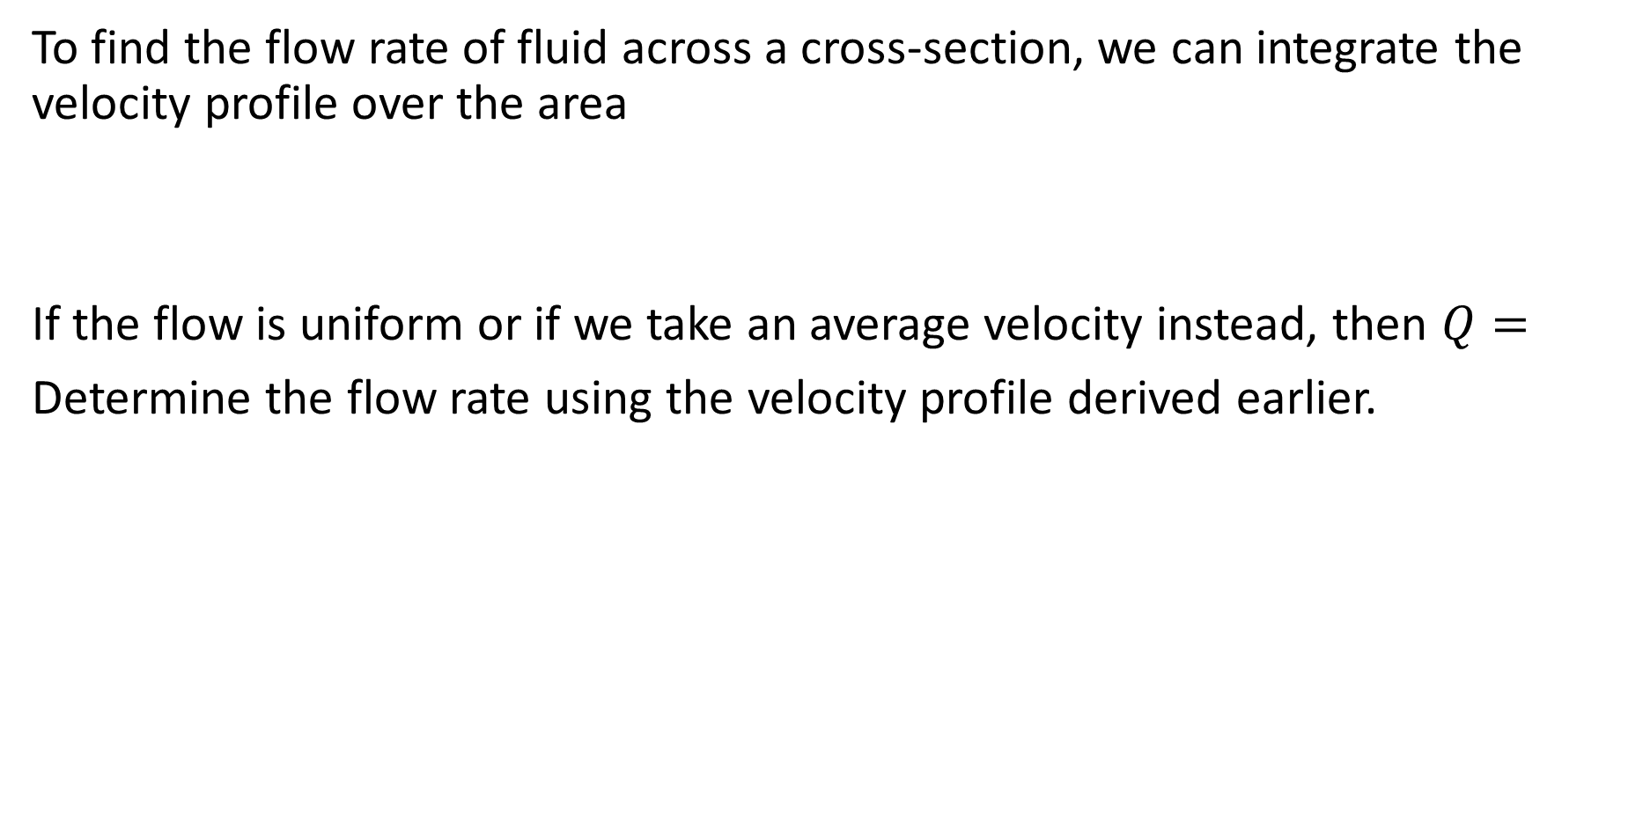
Flow Rates
To find the flow rate of fluid across a cross-section, we can integrate the velocity profile over the area
If the flow is uniform or if we take an average velocity instead, then $Q=$
Determine the flow rate using the velocity profile derived earlier.

Slide 15
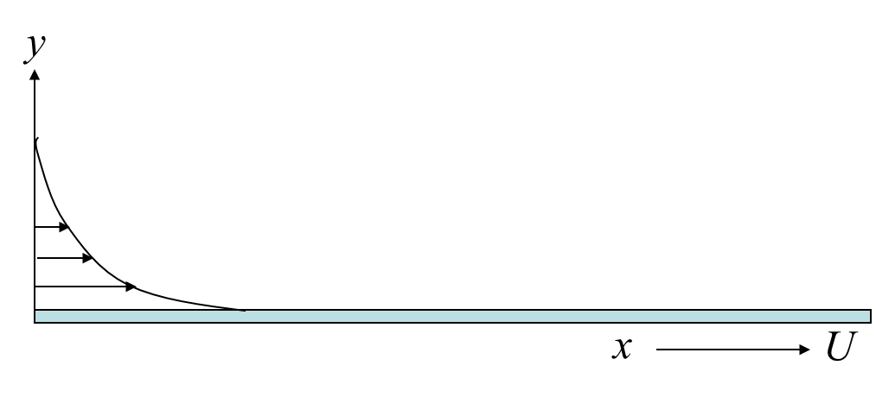
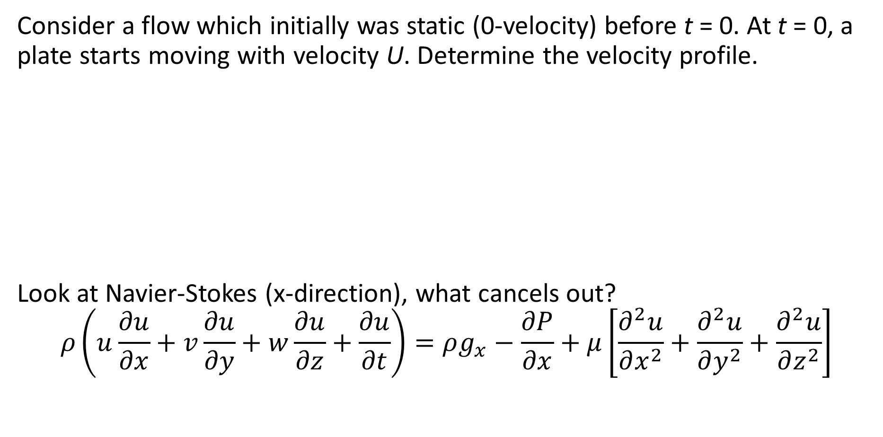
Unsteady Flow Case
Consider a flow which initially was static (0-velocity) before t = 0. At t = 0, a plate starts moving with velocity U. Determine the velocity profile.
Look at Navier-Stokes (x-direction), what cancels out?
$$ρ\left(u\frac{∂u}{∂x}+v\frac{∂u}{∂y}+w\frac{∂u}{∂z}+\frac{∂u}{∂t}\right)=ρg_{x}−\frac{∂P}{∂x}+μ\left[\frac{∂^{2}u}{∂x^{2}}+\frac{∂^{2}u}{∂y^{2}}+\frac{∂^{2}u}{∂z^{2}}\right]$$

Slide 16
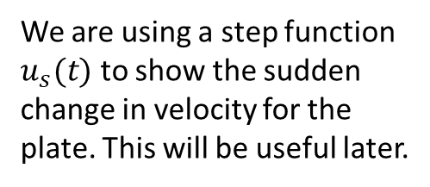
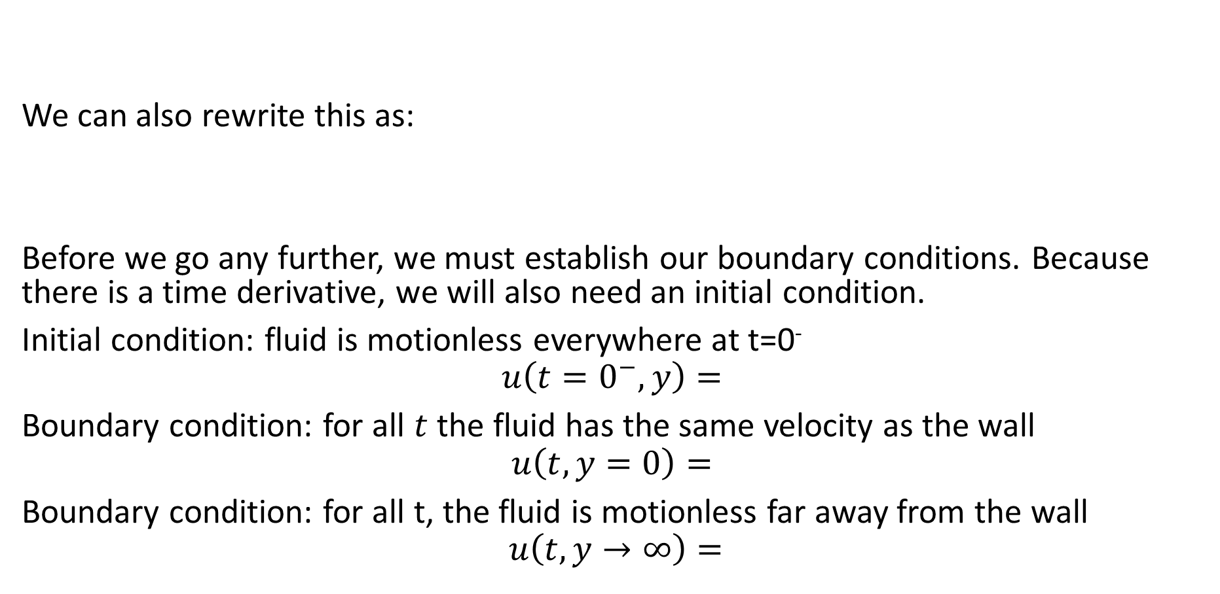
Unsteady Flow Case
We can also rewrite this as:
Before we go any further, we must establish our boundary conditions. Because there is a time derivative, we will also need an initial condition.
Initial condition: fluid is motionless everywhere at t=0⁻
$$u\left(t=0^{−},y\right)=$$
Boundary condition: for all $t$ the fluid has the same velocity as the wall
$$u\left(t,y=0\right)=$$
Boundary condition: for all t, the fluid is motionless far away from the wall
$$u\left(t,y→∞\right)=$$
We are using a step function $u_{s}(t)$ to show the sudden change in velocity for the plate. This will be useful later.

Slide 17
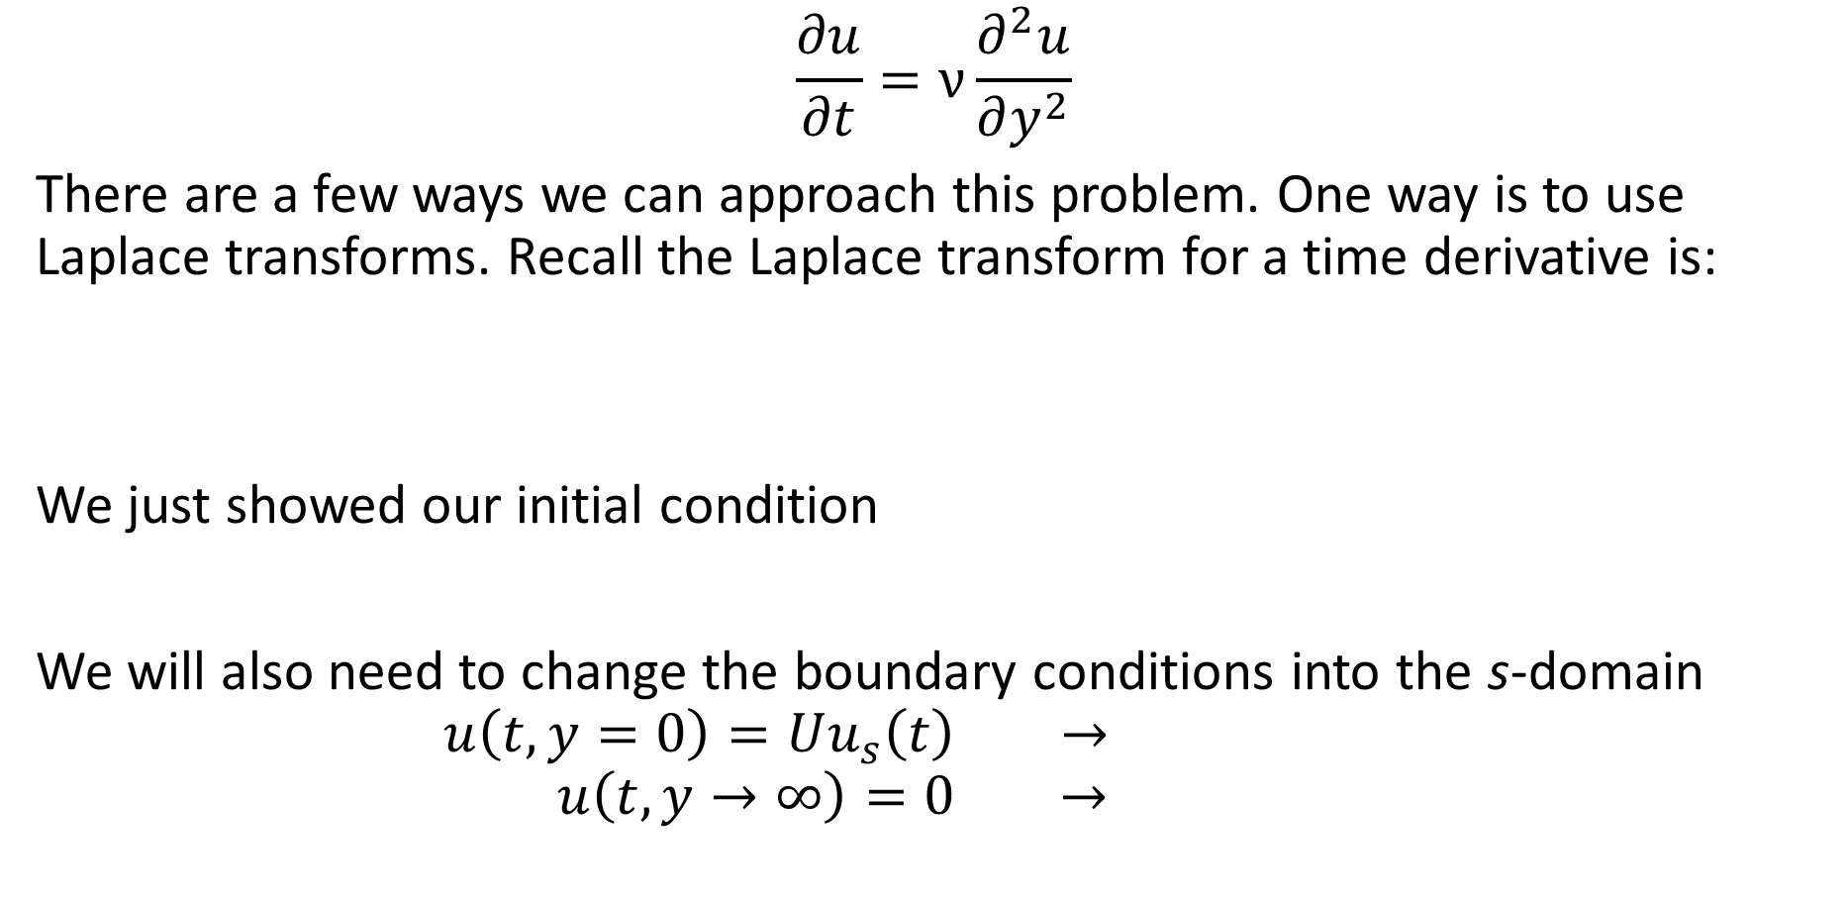
Unsteady Flow Case
$$\frac{∂u}{∂t}=ν\frac{∂^{2}u}{∂y^{2}}$$
There are a few ways we can approach this problem. One way is to use Laplace transforms. Recall the Laplace transform for a time derivative is:
We just showed our initial condition
We will also need to change the boundary conditions into the s-domain
$$u\left(t,y=0\right)=Uu_{s}\left(t\right) →$$
$$u\left(t,y→∞\right)=0 →$$

Slide 18
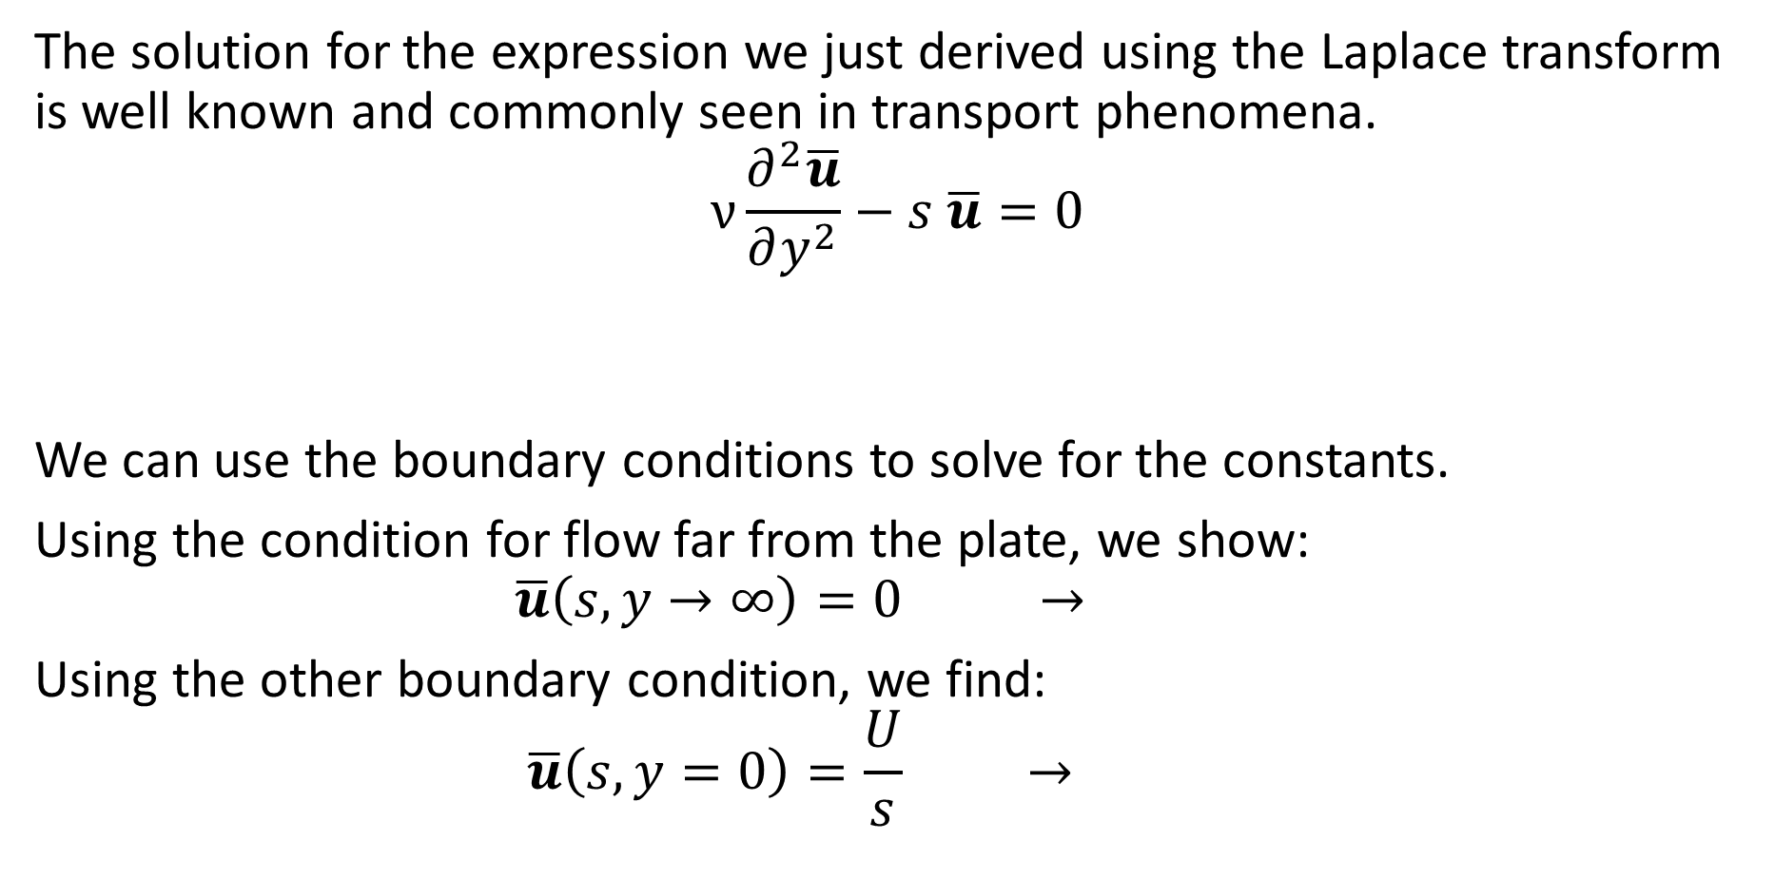
Unsteady Flow Case
The solution for the expression we just derived using the Laplace transform is well known and commonly seen in transport phenomena.
$$ν\frac{∂^{2}\overline{u}}{∂y^{2}}−s \overline{u}=0$$
We can use the boundary conditions to solve for the constants.
Using the condition for flow far from the plate, we show:
$$\overline{u}\left(s,y→∞\right)=0 →$$
Using the other boundary condition, we find:
$$\overline{u}\left(s,y=0\right)=\frac{U}{s} →$$

Slide 19
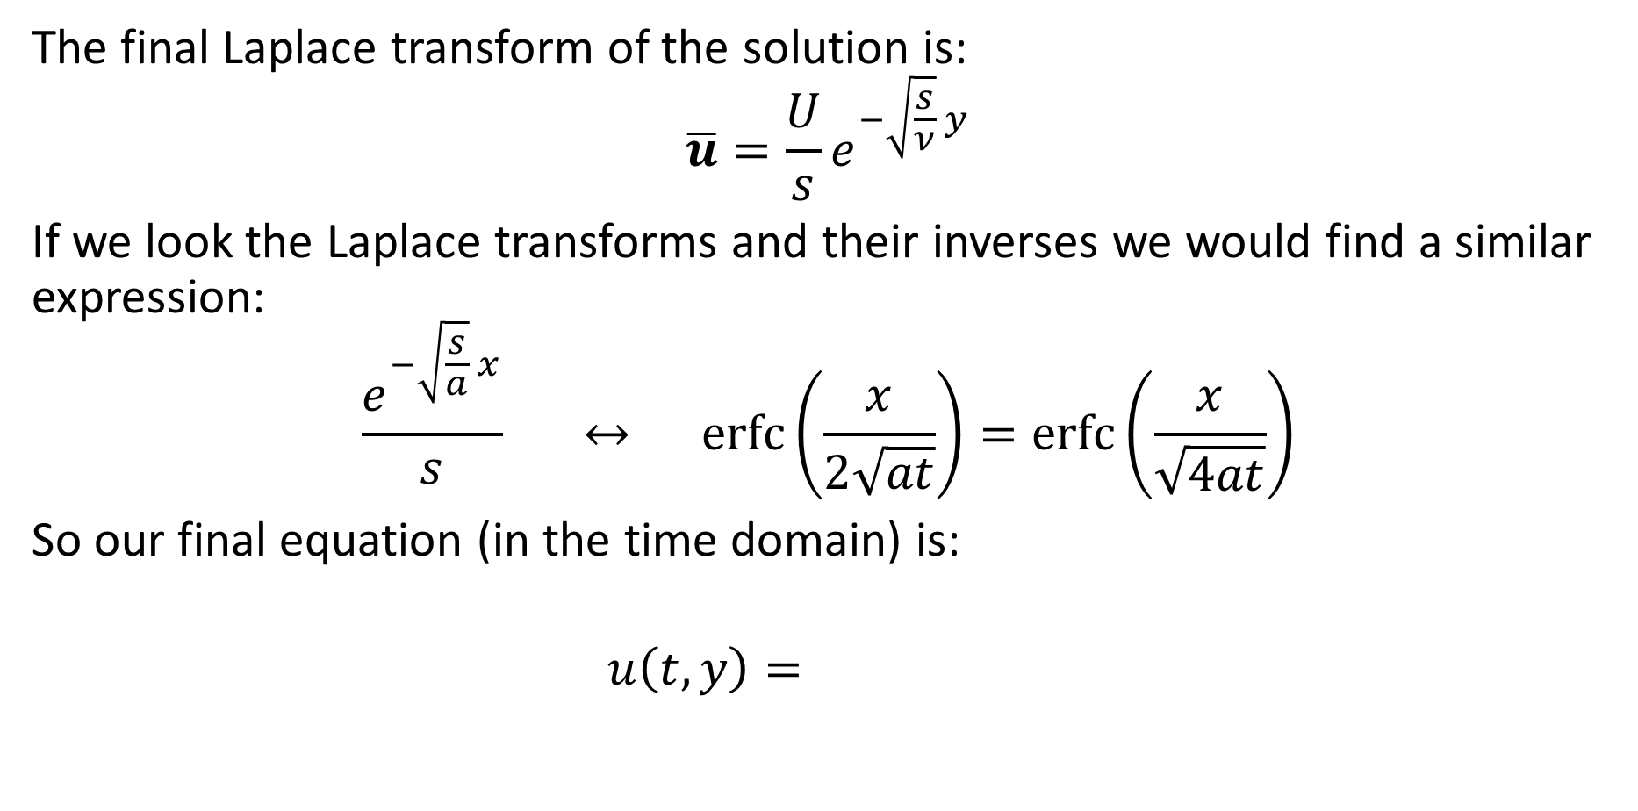
Unsteady Flow Case
The final Laplace transform of the solution is:
$$\overline{u}=\frac{U}{s}e^{−\sqrt{\frac{s}{ν}} y}$$
If we look the Laplace transforms and their inverses we would find a similar expression:
$$\frac{e^{−\sqrt{\frac{s}{a}} x}}{s} ↔ \operatorname{erfc}\left(\frac{x}{2\sqrt{at}}\right)=\operatorname{erfc}\left(\frac{x}{\sqrt{4at}}\right)$$
So our final equation (in the time domain) is:
$$u\left(t,y\right)=$$

Slide 20
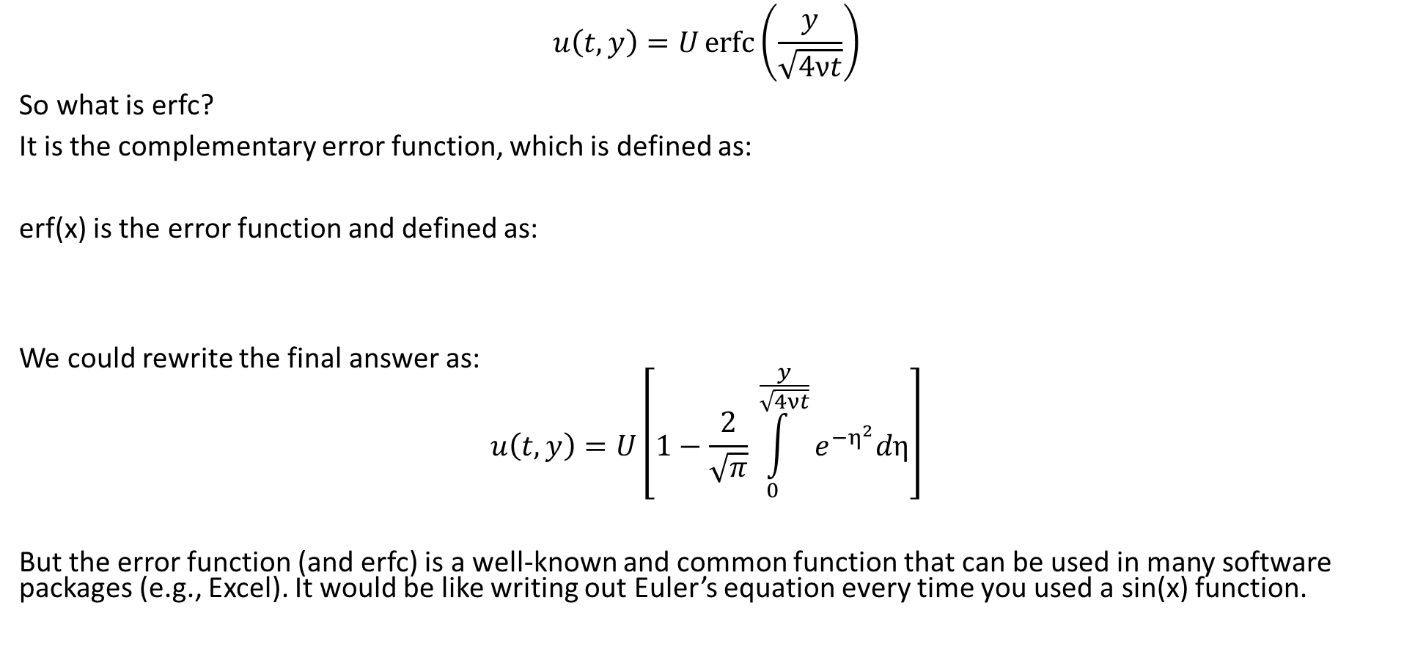
Error Function
$$u\left(t,y\right)=U\operatorname{erfc}\left(\frac{y}{\sqrt{4νt}}\right)$$
So what is erfc?
It is the complementary error function, which is defined as:
erf(x) is the error function and defined as:
We could rewrite the final answer as:
$$u\left(t,y\right)=U\left[1−\frac{2}{\sqrt{π}} \int_{0}^{\frac{y}{\sqrt{4νt}}}{e^{−η^{2}}dη}\right]$$
But the error function (and erfc) is a well-known and common function that can be used in many software packages (e.g., Excel). It would be like writing out Euler’s equation every time you used a sin(x) function.

Slide 21
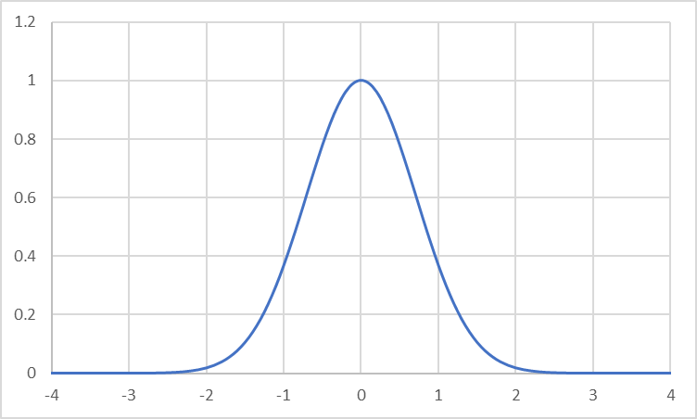
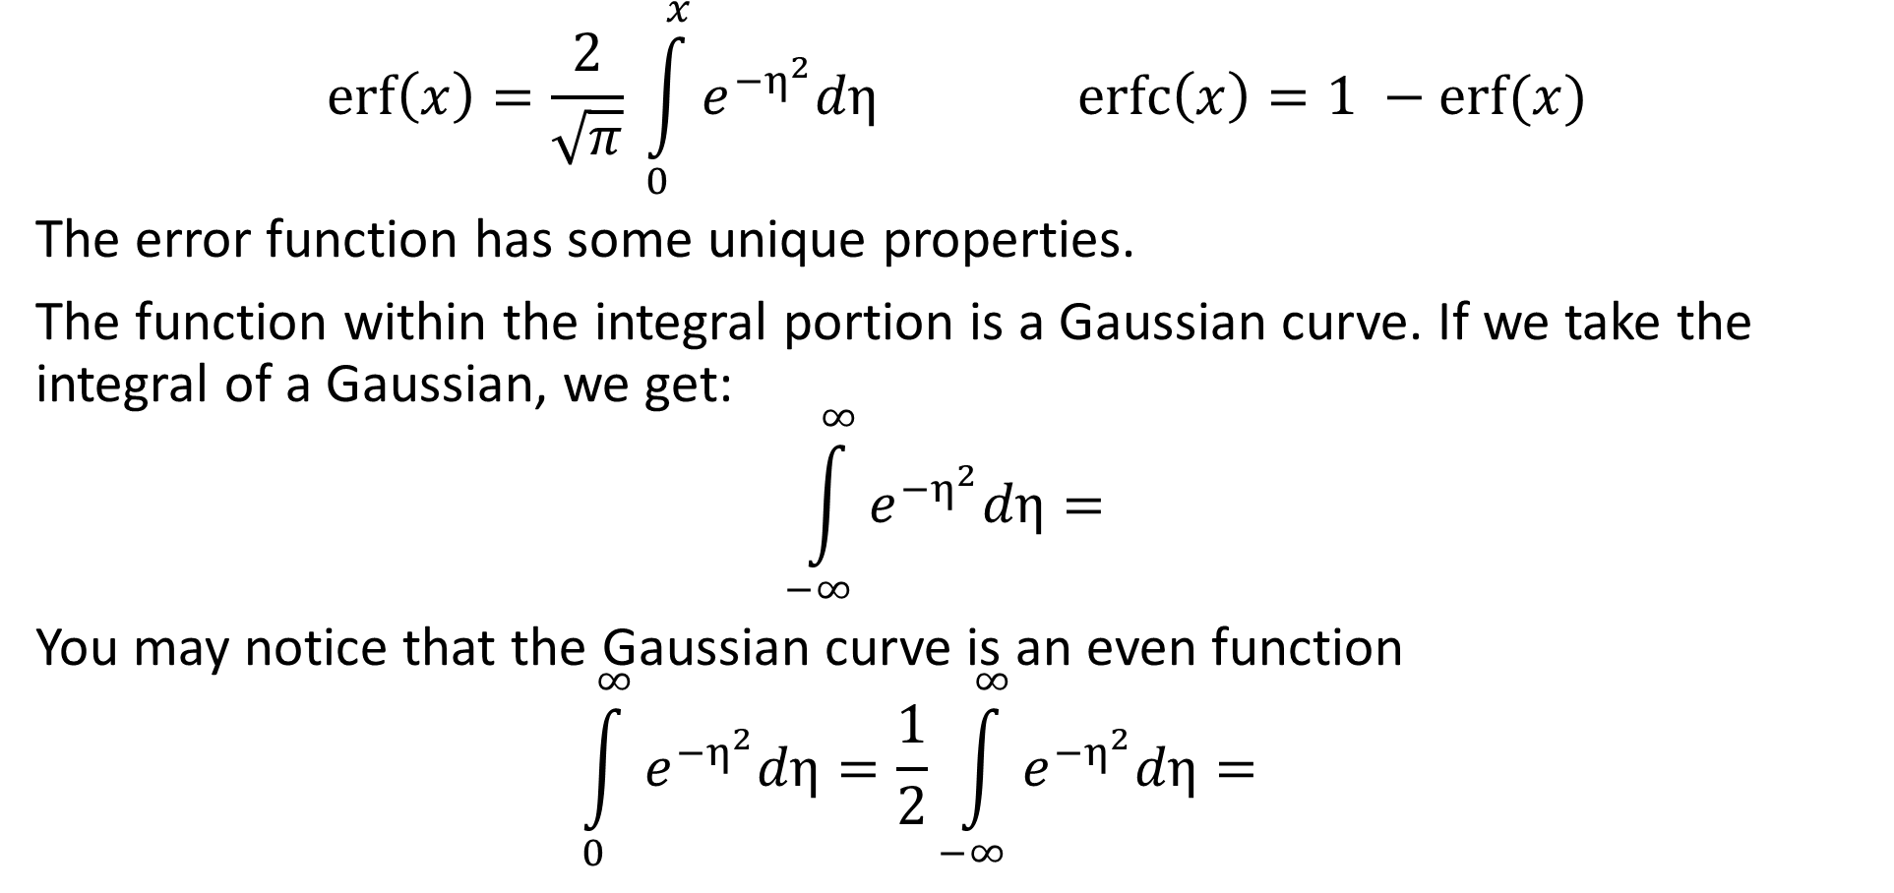
Error Function Properties
$$\operatorname{erf}\left(x\right)=\frac{2}{\sqrt{π}} \int_{0}^{x}{e^{−η^{2}}dη} \operatorname{erfc}\left(x\right)=1 −erf⁡(x)$$
The error function has some unique properties.
The function within the integral portion is a Gaussian curve. If we take the integral of a Gaussian, we get:
$$\int_{−∞}^{∞}{e^{−η^{2}}dη}=$$
You may notice that the Gaussian curve is an even function
$$\int_{0}^{∞}{e^{−η^{2}}dη}=\frac{1}{2}\int_{−∞}^{∞}{e^{−η^{2}}dη}=$$

Slide 22
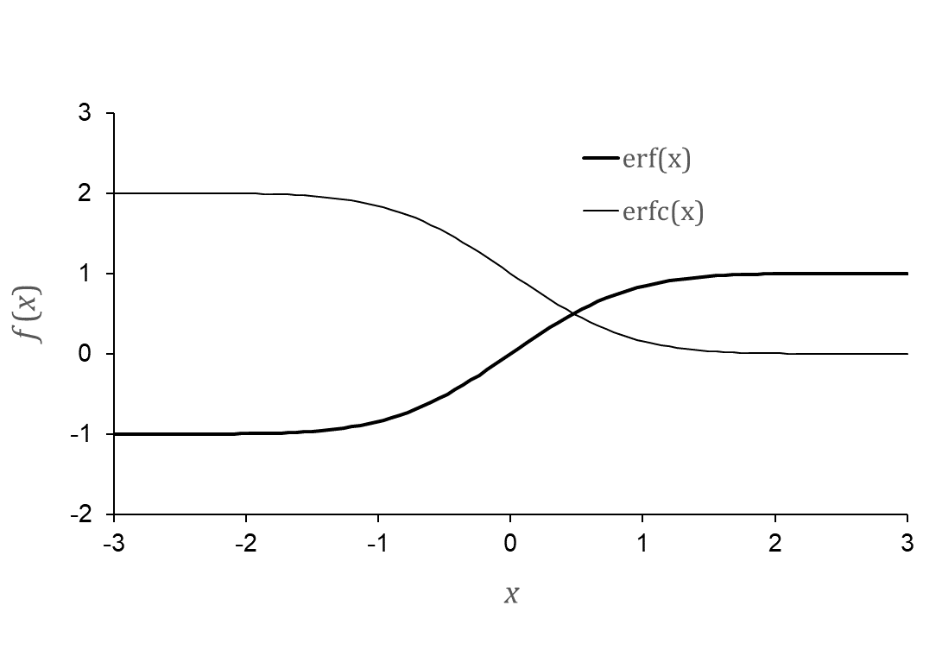
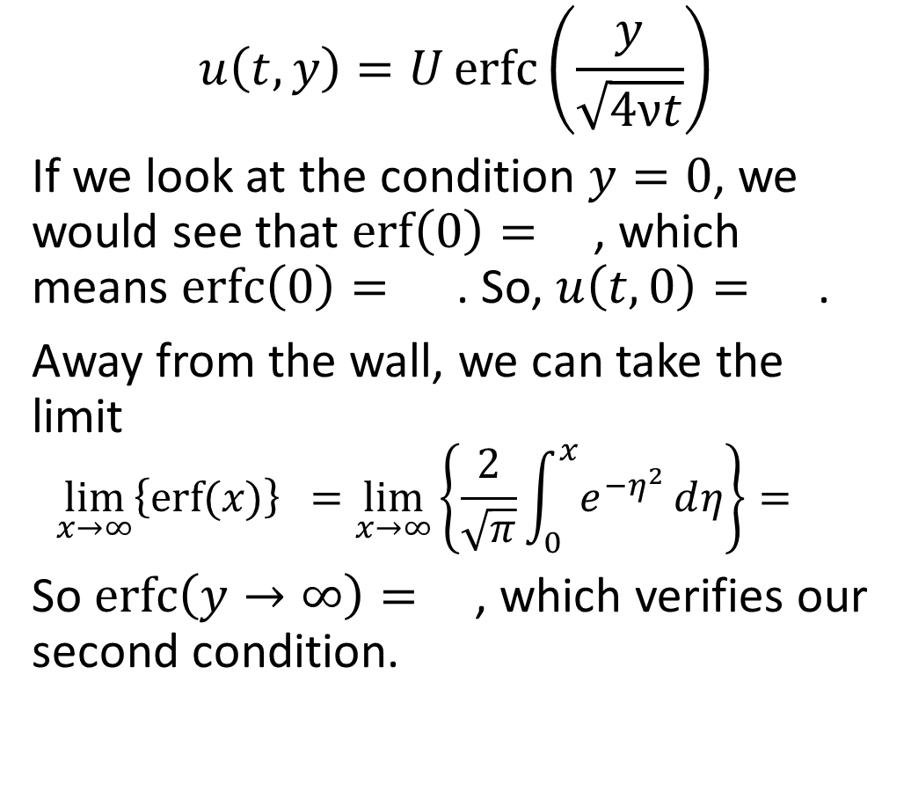
Checking Boundary Conditions
$$u\left(t,y\right)=U\operatorname{erfc}\left(\frac{y}{\sqrt{4νt}}\right)$$
If we look at the condition $y=0$, we would see that $\operatorname{erf}\left(0\right)=$, which means $\operatorname{erfc}\left(0\right)=$. So, $u\left(t,0\right)=$.
Away from the wall, we can take the limit
$$\lim_{x→∞}\left\{\operatorname{erf}{(x)}\right\}{ }=\lim_{x→∞}\left\{\frac{2}{\sqrt{π}}\int_{0}^{x}{e^{{−η}^{2}}ⅆη}\right\}={ }$$
So $\operatorname{erfc}\left(y→∞\right)=$, which verifies our second condition.

Slide 23
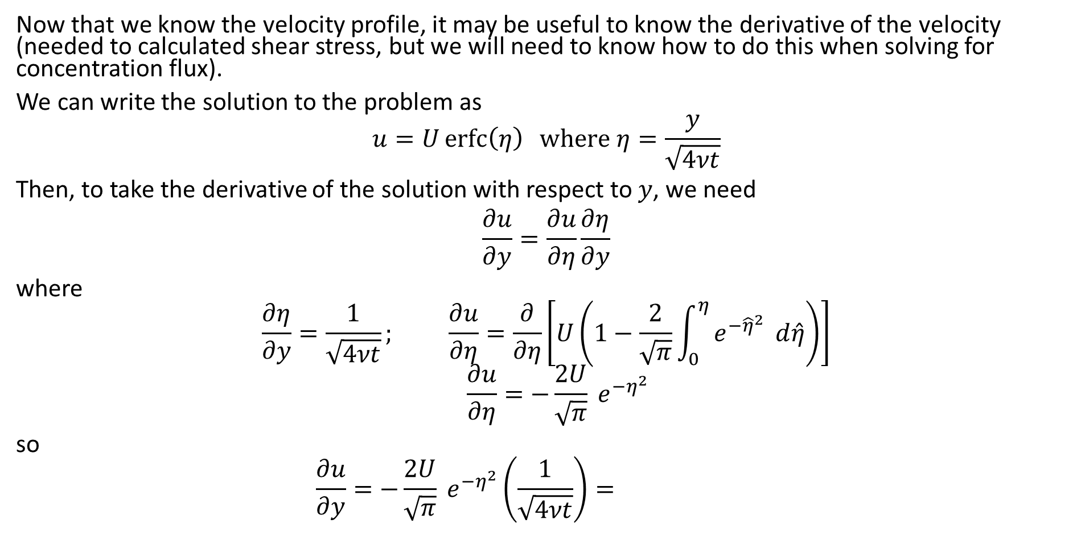
Derivative of Error Function
Now that we know the velocity profile, it may be useful to know the derivative of the velocity (needed to calculated shear stress, but we will need to know how to do this when solving for concentration flux).
We can write the solution to the problem as
$$u=U\operatorname{erfc}\left(η\right) \text{where} η=\frac{y}{\sqrt{4νt}}$$
Then, to take the derivative of the solution with respect to $y$, we need
$$\frac{∂u}{∂y}=\frac{∂u}{∂η}\frac{∂η}{∂y}$$
where
$$\frac{∂η}{∂y}=\frac{1}{\sqrt{4νt}}; \frac{∂u}{∂η}=\frac{∂}{∂η}\left[U\left(1−\frac{2}{\sqrt{π}}\int_{0}^{η}{e^{−{\hat{η}}^{2}} ⅆ\hat{η}}\right)\right]$$
$$\frac{∂u}{∂η}=−\frac{2U}{\sqrt{π}} e^{−η^{2}}$$
so
$$\frac{∂u}{∂y}=−\frac{2U}{\sqrt{π}} e^{−η^{2}}\left(\frac{1}{\sqrt{4νt}}\right)=$$

Slide 24
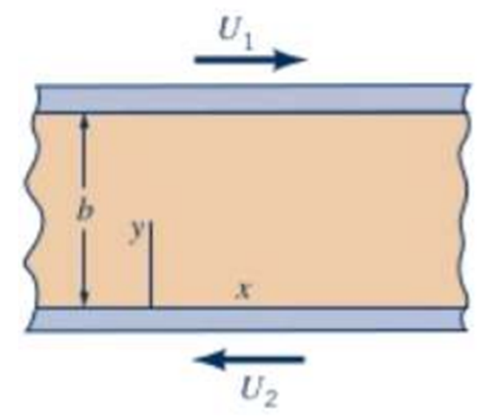

Class Problem
An incompressible, Newtonian fluid is placed between two moving horizontal, infinite, parallel plates. Assume there is no pressure gradient in the x-direction, and gravity does not act in the x-direction. The plates are spaced b = 1.2 m apart. The velocity of the top plate is $U_{1}=2\frac{m}{s}$, and the velocity of the bottom plate is $U_{2}=5\frac{m}{s}$ (note the directions). Determine (A) where (in the y-direction) a stagnant point may occur, (B) the volumetric flow rate, and (C) the average velocity.

Slide 25
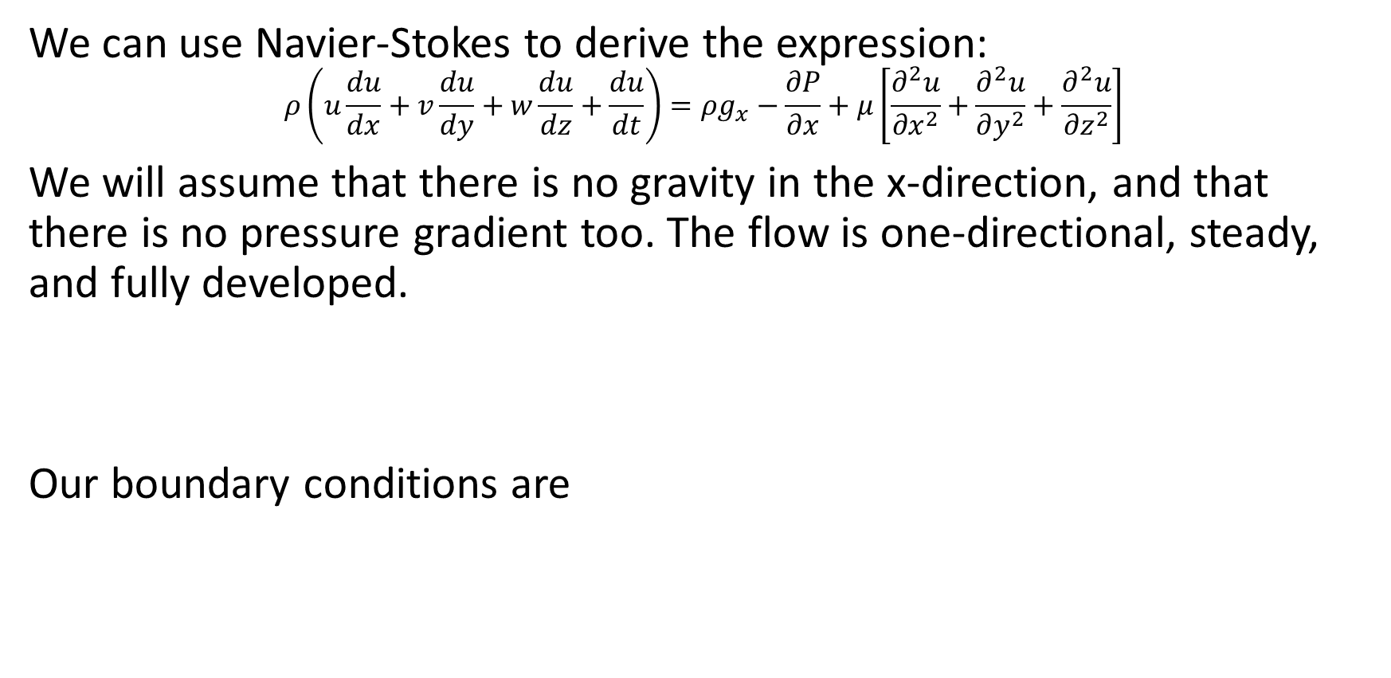
Class Problem – Solution
We can use Navier-Stokes to derive the expression:
$$ρ\left(u\frac{du}{dx}+v\frac{du}{dy}+w\frac{du}{dz}+\frac{du}{dt}\right)=ρg_{x}−\frac{∂P}{∂x}+μ\left[\frac{∂^{2}u}{∂x^{2}}+\frac{∂^{2}u}{∂y^{2}}+\frac{∂^{2}u}{∂z^{2}}\right]$$
We will assume that there is no gravity in the x-direction, and that there is no pressure gradient too. The flow is one-directional, steady, and fully developed.
Our boundary conditions are

Slide 26
Class Problem – Solution

Slide 27
Class Problem – Alternative Solution

Slide 28
Class Problem – Solution
To find the stagnant point we set the velocity to 0 and find y

Slide 29
Class Problem – Solution
The volumetric flow rate can be found by integrating the velocity over the area. Since we don’t know the width of the plates, we can find the flow rate per width

Slide 30
Class Problem – Solution
To find the average velocity, we can take the flow rate and divide by the area:

